Slide 1
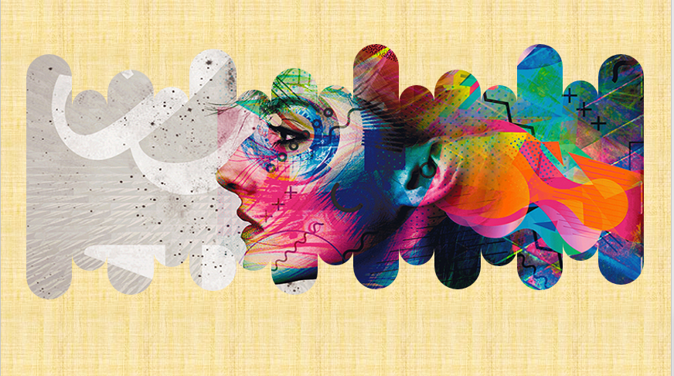
G r a p h i c
D e s i g n

Slide 2
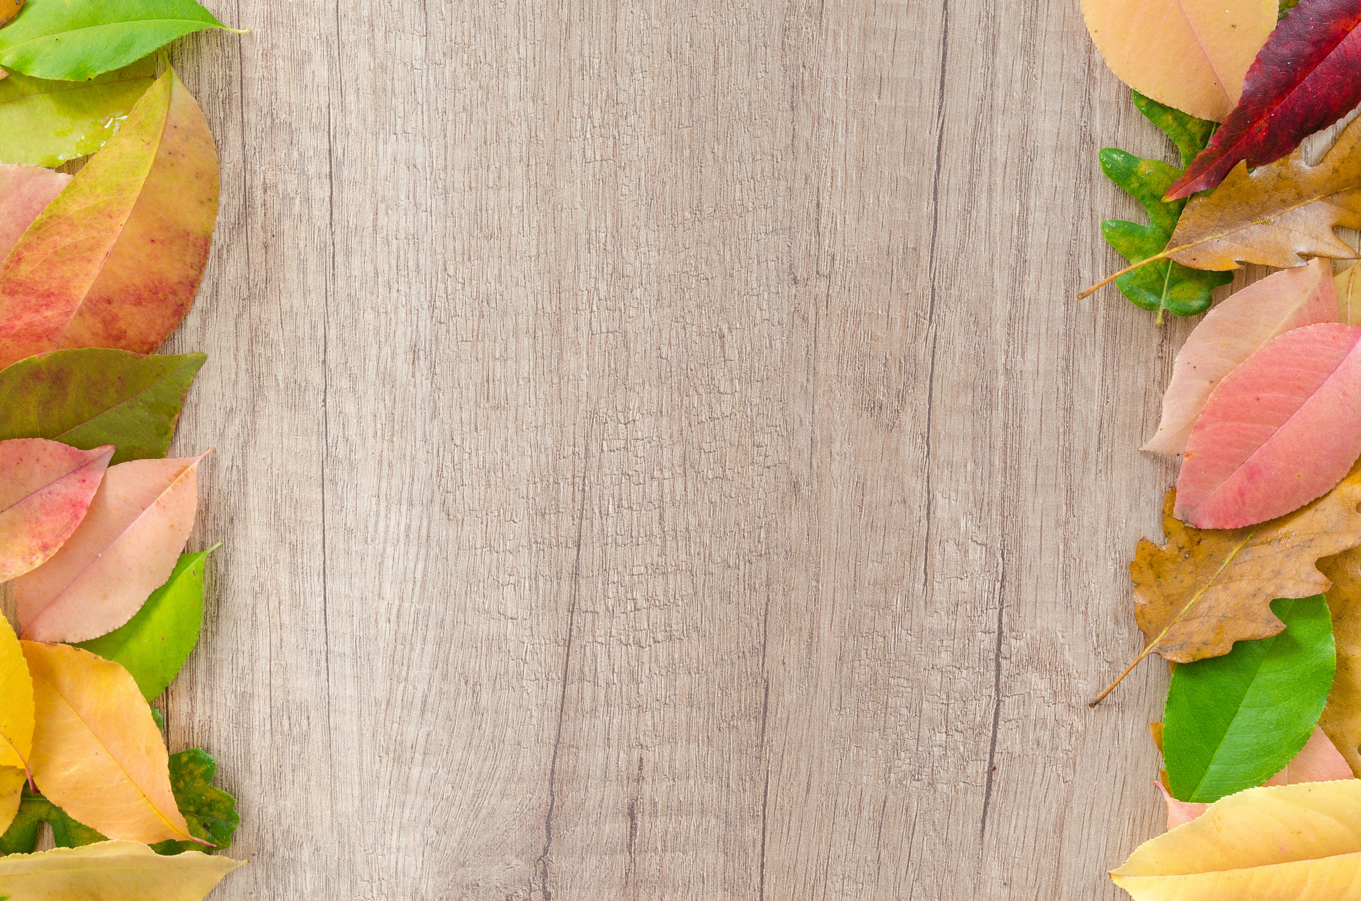
What is Graphic Design?
Graphic design is a visual communication discipline that combines art and technique. Its goal is to generate aesthetic expressions of different concepts and messages.

Slide 3
What are the basic elements of Graphic Design?
Graphic design elements are the basic units that we use to build images and compositions. If a final design were a wall, every brick would be a design element. Let’s explain the most important ones!.

Slide 4
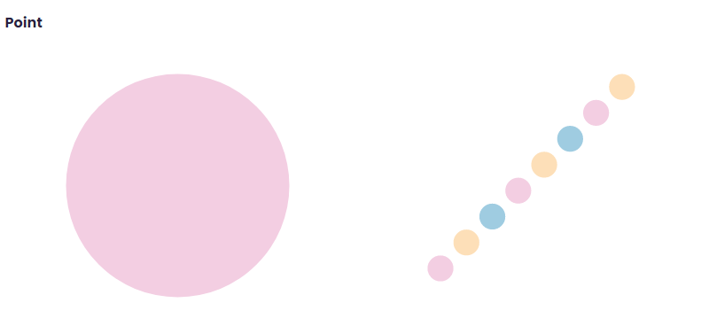
A point is the most fundamental expression of visual representation. Its size and shape might vary. That is why we can perceive a spot as a little part of something bigger or as a shape itself. Our perception depends on the context.

Slide 5
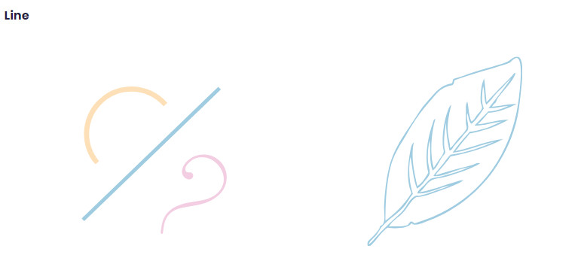
A line is a structure composed of several points. Our brain can perceive lines even when there is not an intentional representation. There are different kinds of lines: straight, curved, continuous, discontinuous, etc.

Slide 6
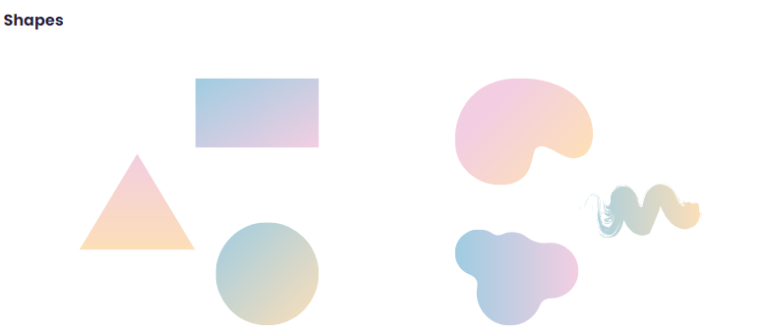
Shapes are forms, compositions made of lines combined in different ways. Circles, squares, and triangles are some popular kinds of shapes. These elements can take infinite abstract forms.

Slide 7
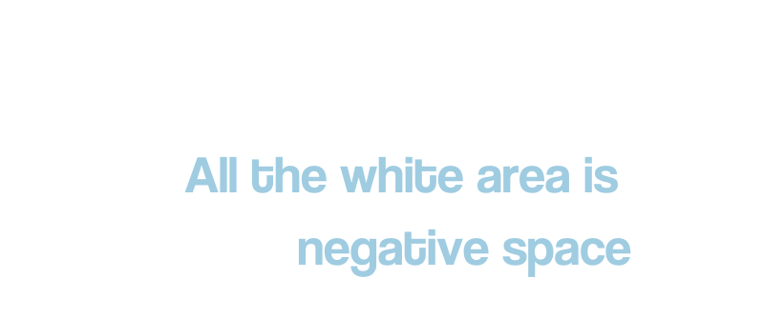
Negative Space
This term is the scientific name of the background. In any composition, shapes lay on a surface. It can be full or empty, and its size can change depending on the design.

Slide 8
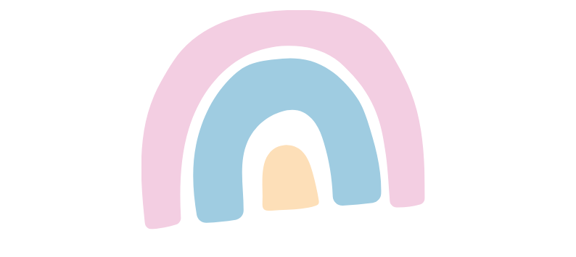
Color
Color is the most noticeable element of graphic design. We relate it to emotions, and it has a significant impact on perception. You can work with it by combining different palettes. It is also possible to change its saturation, tint, or shadows to change the aspect of a design.

Slide 9
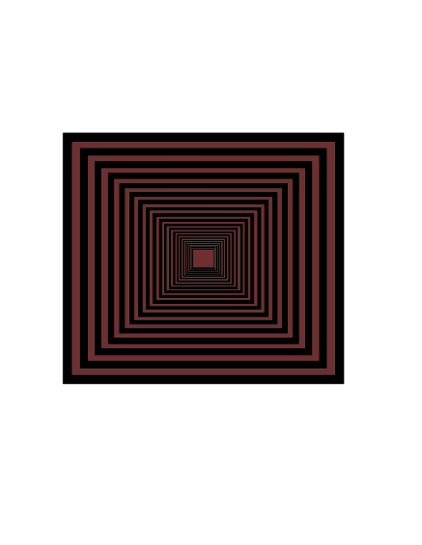
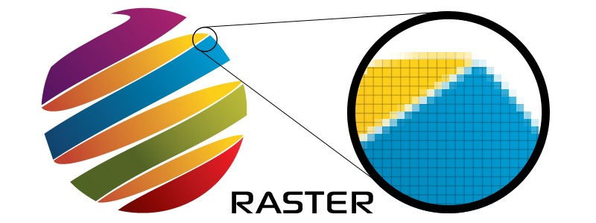
Types Of Graphic Design
Raster Graphic
Vector Graphic
In computer graphics and digital photography, a raster graphics represents a two-dimensional picture as a rectangular matrix or grid of square pixels, viewable via a computer display, paper, or other display medium.
Vector graphics is a form of computer graphics in which visual images are created directly from geometric shapes defined on a Cartesian plane, such as points, lines, curves and polygons.

Slide 10
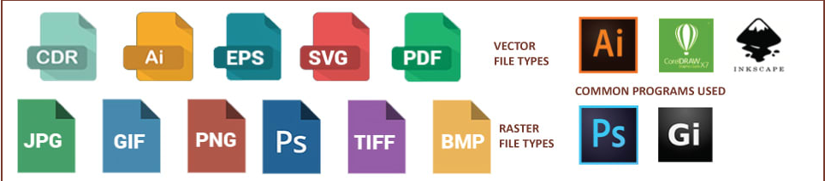

Slide 11
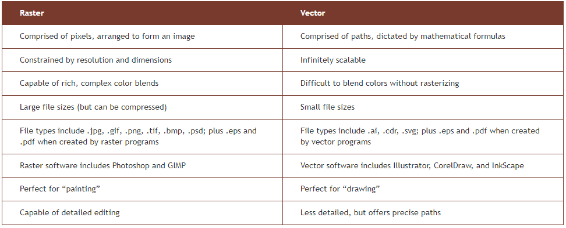

Slide 12
When should you use raster or vector?
Raster images are best for photos, while vectors are best for logos, illustrations, engravings, etchings, product artwork, signage, and embroidery. Some liken raster images to paintings and vectors to drawing; if your project requires complex color blends, such as in painting, raster is the preferred format; if your project requires scalable shapes and solid colors, such as in drawing, vector is the best choice.
Many projects combine raster and vector images together: a brochure, for example, might include a corporate logo (vector) and a photo of happy customers (raster) – often coupled in layout software such as InDesign or QuarkXpress (though Illustrator and Photoshop can also be used to pair raster and vector images).

Slide 13
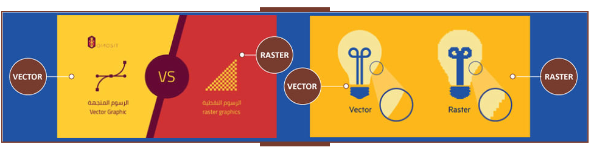
Other examples include printing postcards that feature an illustrated background (vector) with a foreground photo (raster), online catalog printing that features scalable product information tables vector) alongside product images (raster), and business greeting card printing that combines corporate logos (vectors) with photos (rasters).

Slide 14
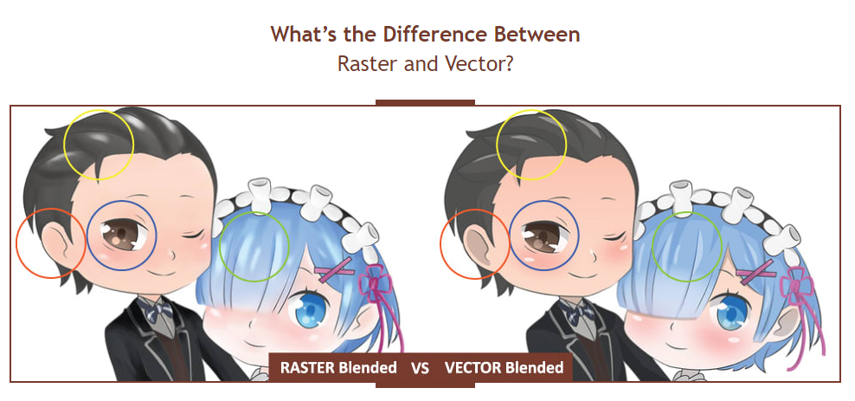

Slide 15
Workplace
Many of these workers are employed in specialized design services, publishing, or advertising, public relations, and related services industries.

Slide 16
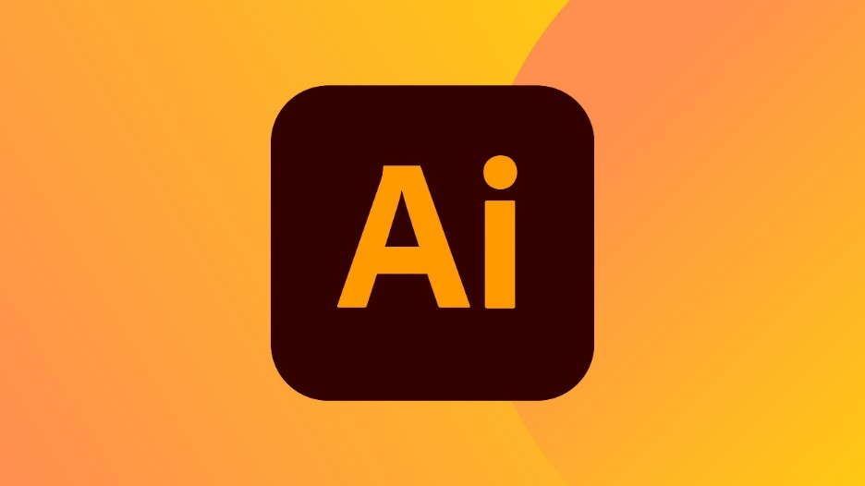
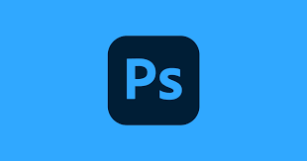
Software For Graphic Design

Slide 17
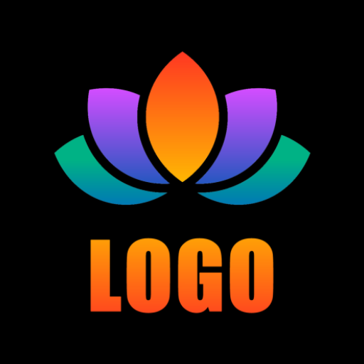
What we learn
Logo Design
What is Logo Design?
With logo design, you have a visual communication tool to help you get your message across to the audience. Logos are composed of text, color, shape, and illustrations. It serves as a self-explanatory image that people can use to connect with your brand.

Slide 18
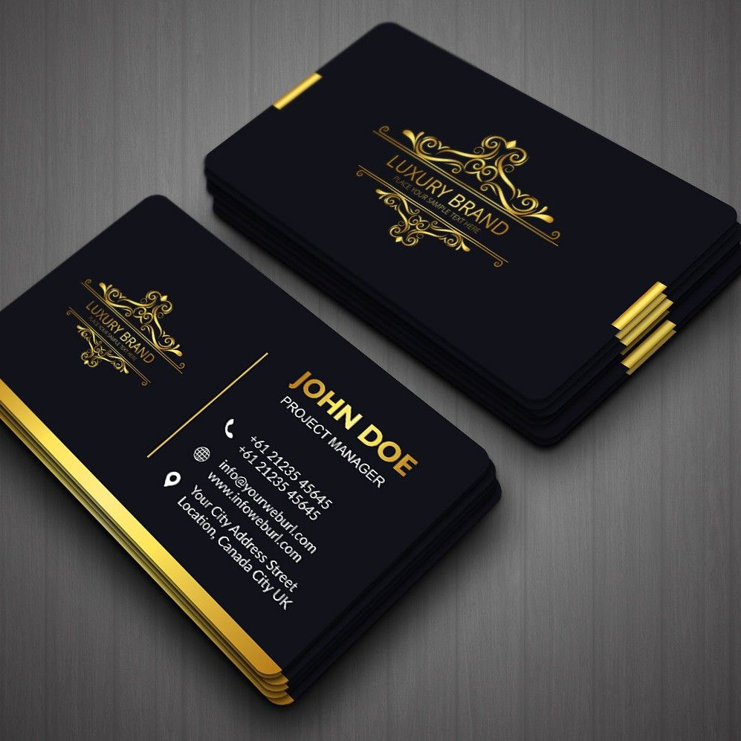
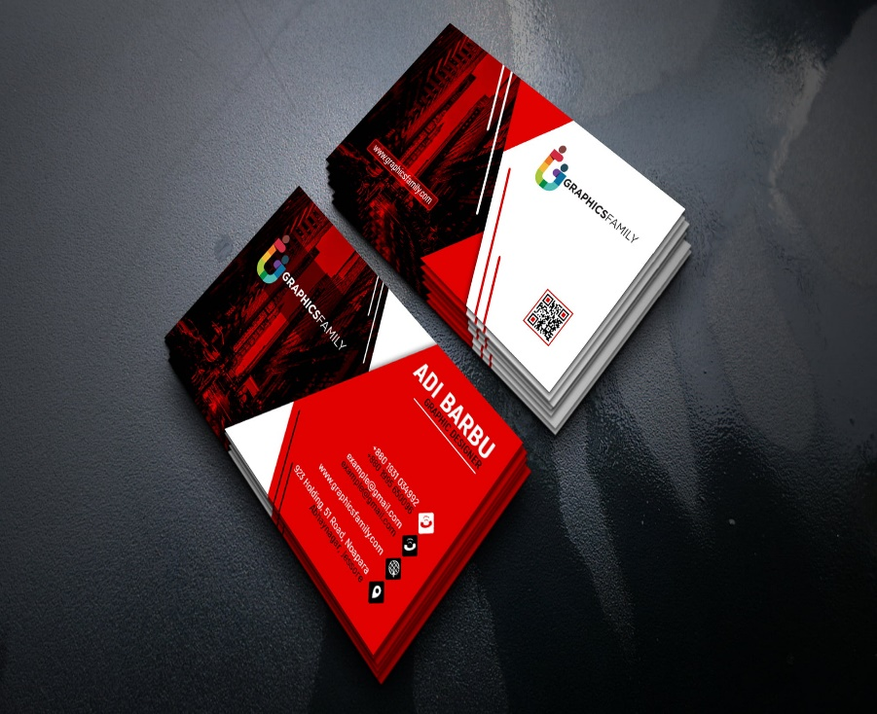
Business Card Design

Slide 19
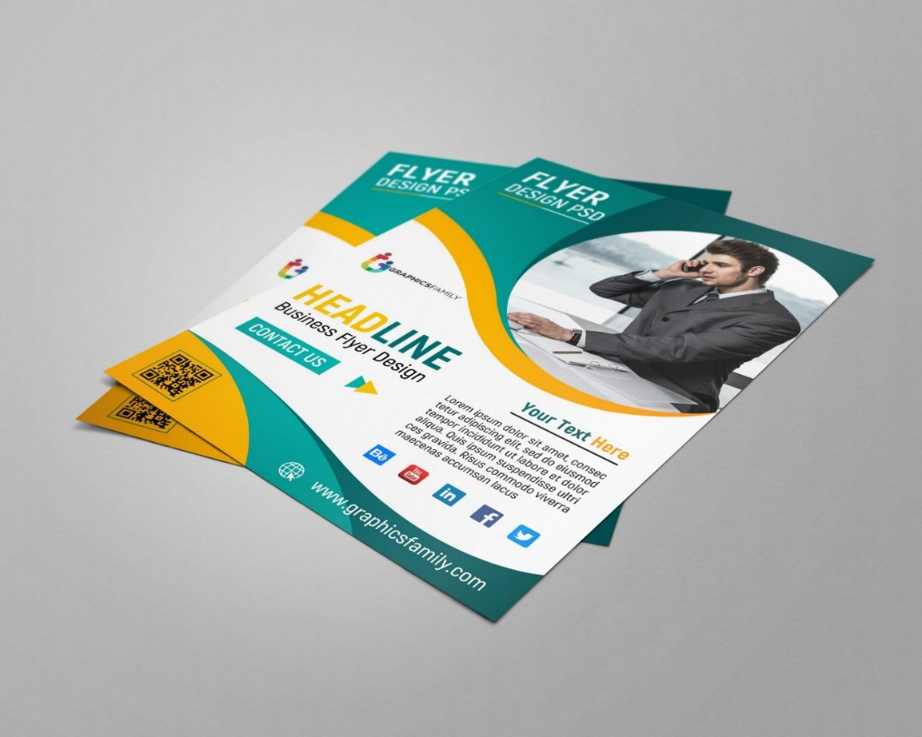
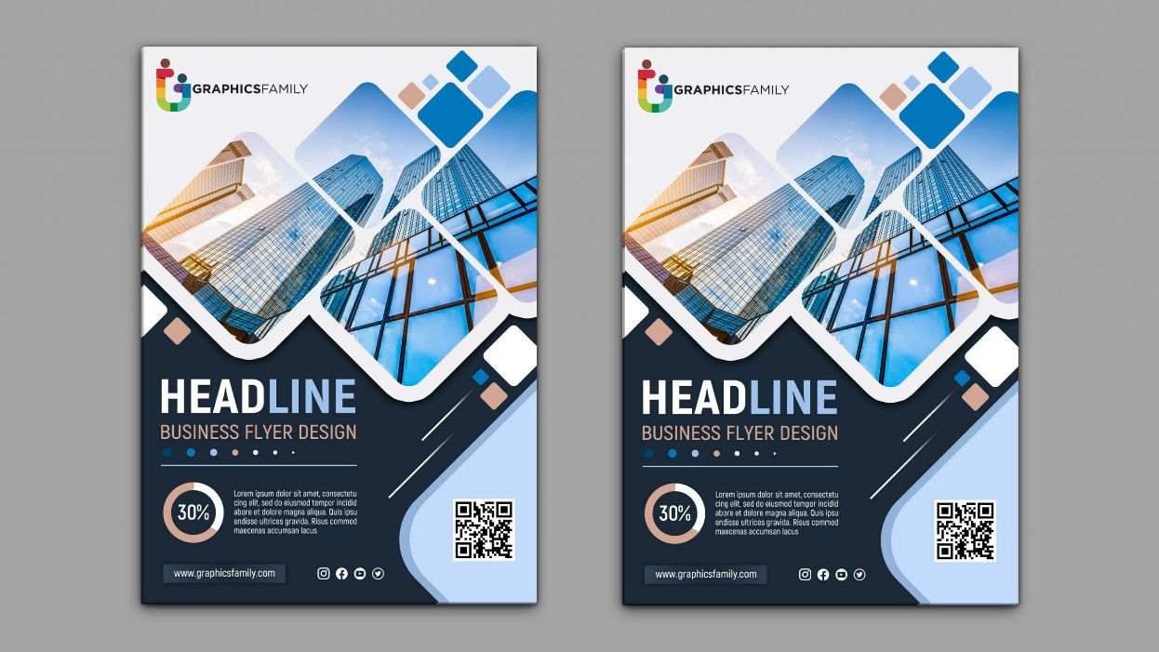
Flyer Design

Slide 20
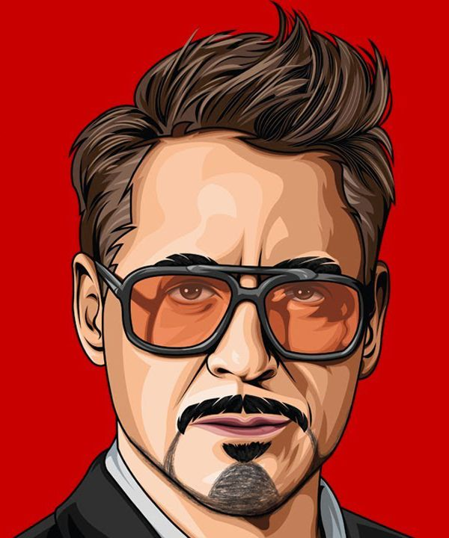
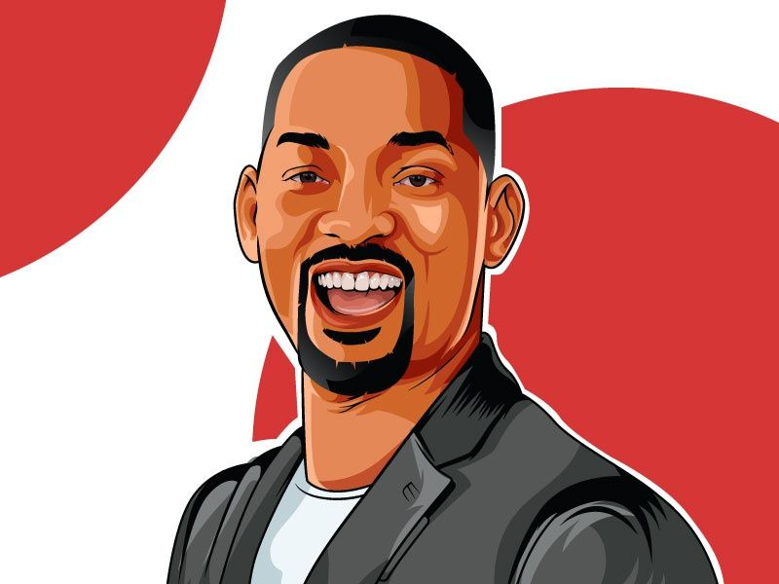
Ai Portrait

Slide 21
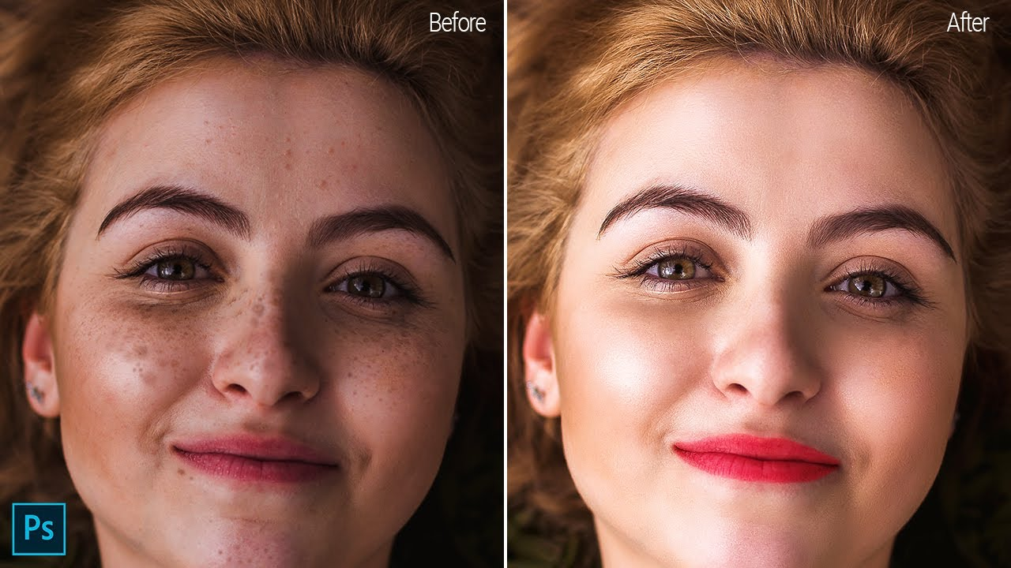
Image Retouch
What is image retouching?
Retouching, or photo editing, is a set of manipulations performed on a digital image to improve it visually or to adjust its technical qualities. Basic retouching methods are resizing, color correction, shape adjustment, or defect removal. Photoshop is one of the most popular software programs used to edit images.

Slide 22
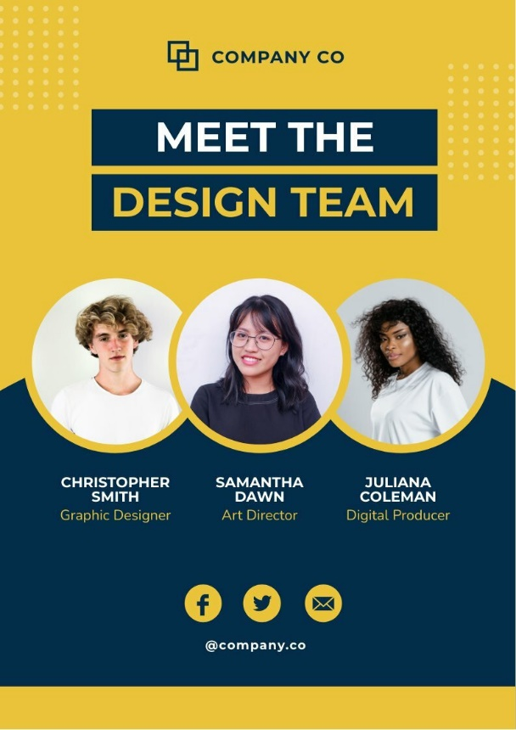
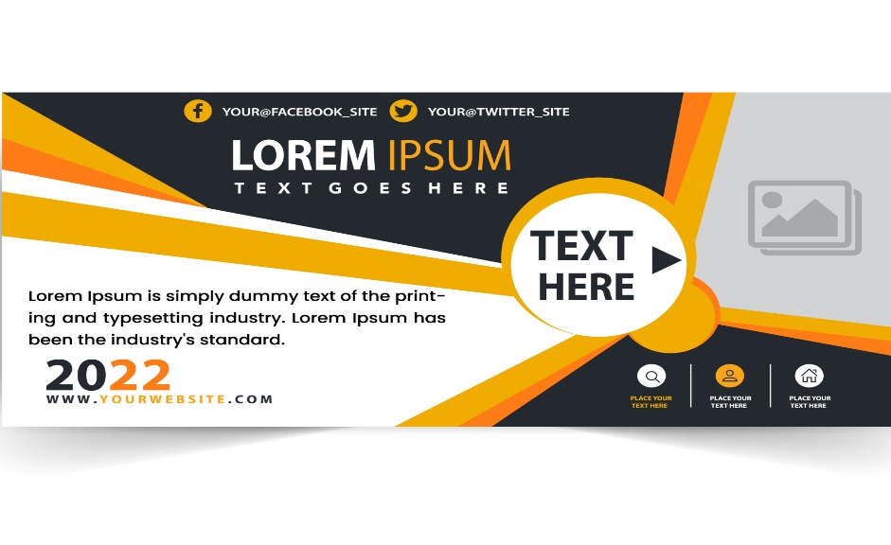
Banner Design
Poster Design

Slide 23
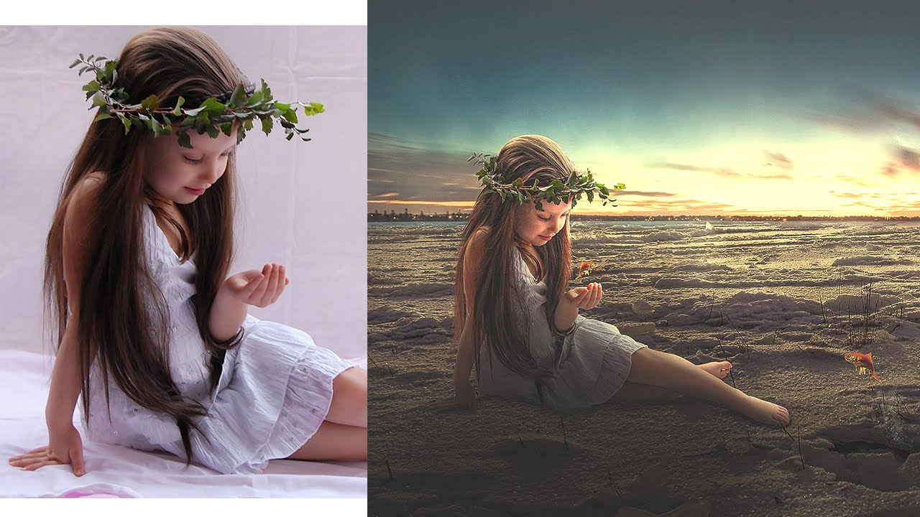
Image Manipulation
What is image manipulation?
Photograph manipulation involves the transformation or alteration of a photograph. Some photograph manipulations are considered to be skillful artwork, while others are considered to be unethical practices, especially when used to deceive.

Slide 24
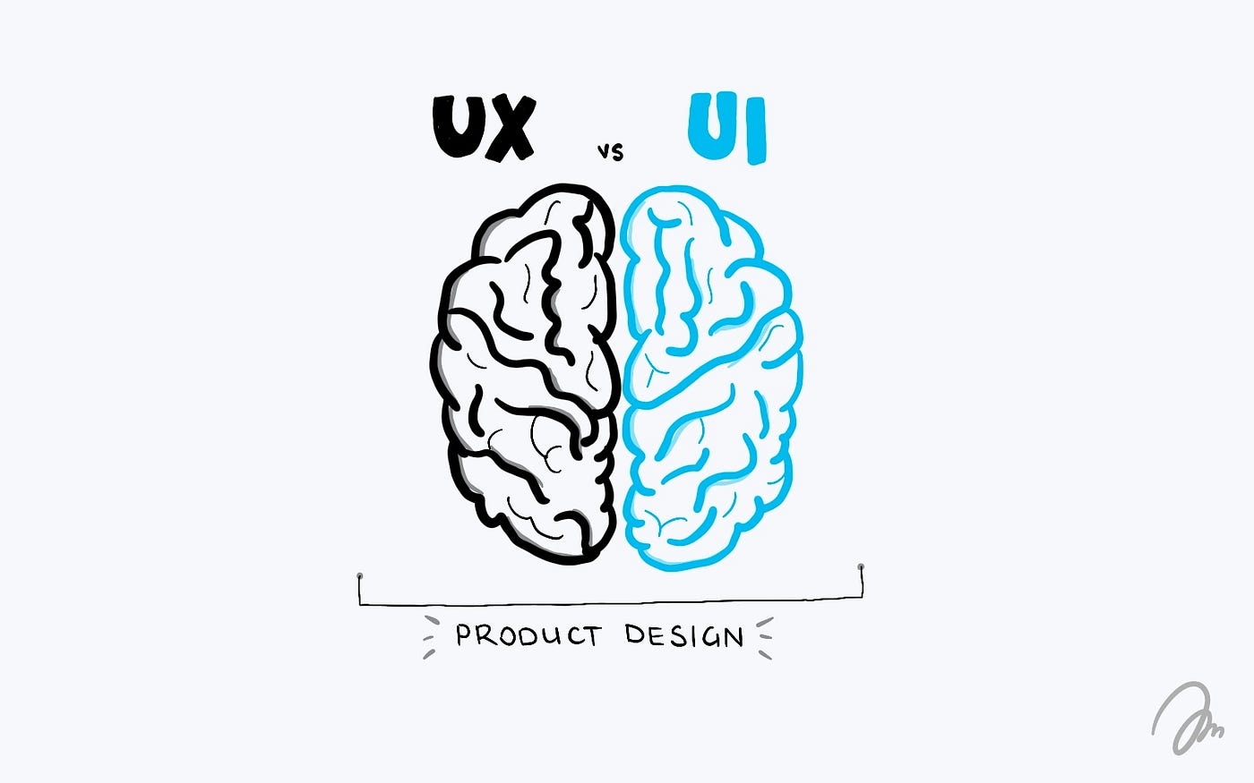
UI/UX
What is UX?
User experience design is the process of defining the experience a user would go through when interacting with a company, its services, and its products. Design decisions in UX design are often driven by research, data analysis, and test results rather than aesthetic preferences and opinions.
What is UI?
In the industrial design field of human–computer interaction, a user interface is the space where interactions between humans and machines occur.

Slide 25
Any Question?

Slide 26
